Slide 1

Rebuilding a Research:
Hybrid Hypercube Optimization Search Algorithm and Multilayer Perceptron Neural Network for Medical Data Classification
A detailed exploration of the research article, focusing on methodology, and implementation steps as the computational intelligence course final project.
Supervisor: Dr. Fahimeh Nazarimehr, Eng. Ahmadi
Mahtab Dastranj – 40033024

Slide 2

Roadmap;
1. Literature review
2. Rebuilding
Approach, Methodology and specifications
Dataset, Implementation, Comparison and Results

Slide 3

Medical Data Classification
Traditional Method
Optimization algorithms
New Optimization Algorithm
The most commonly used gradient-based learning method of MLP: The backpropagation (BP) algorithm.
sluggish convergence
high reliance on initial solutions,
proclivity for getting stuck in local optima.
Alternative to Gradient-based MLP
issue of slow convergence rate and trapping in local optima remains partially unsolved.
GA, BAT, FPA
Outstanding performance in escaping local optima and fast convergence speed.
Compared to other Swarm-based OAs:
Fewer Parameters
Easy and Simple
Adaptable
Lowest MSE average obtained

Slide 4
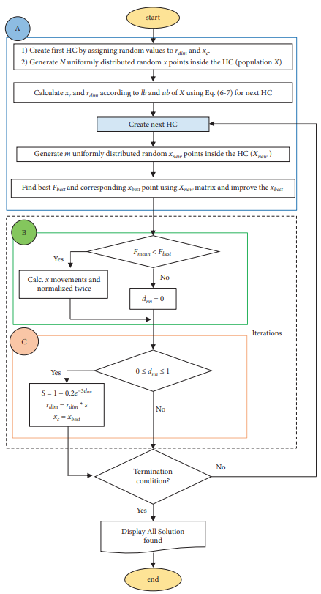
Methodology:
Hybrid HOS and MLP Neural Network
Used as a training method for MLPs
STAGES | Training Approaches
A) The initialization process | A) Initialization
B) The displacement-shrink process | B) Fitness evaluation
C) The searching areas process | C) Creating new HC and update solutions
 | D) Steps 2 and 3 are repeated until the full number of iterations is completed

Slide 5
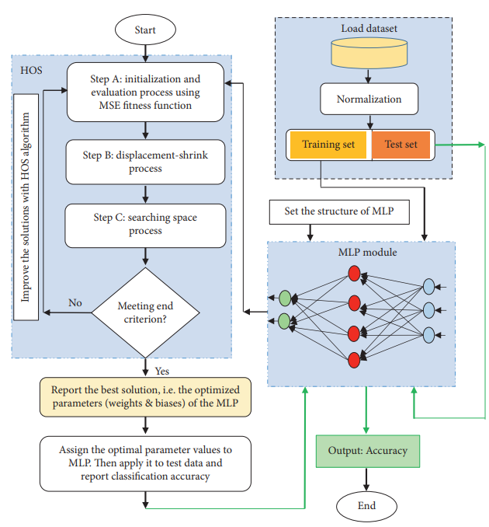
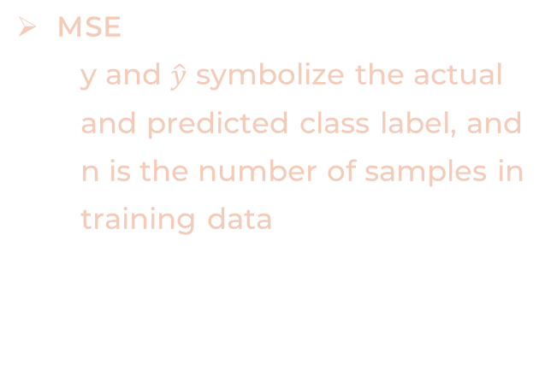
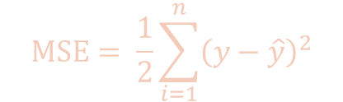
Key points
Number of neurons
Specifications
In the input and output layers: specified by the dataset’s total number of features and labels
Within the hidden layer (H) using Kolmogorov theorem :
H = 2 ∗ Input + 1
All medical datasets are split into two parts: 66.66% of the data is used for the training set, and the remaining (33.33%) for validation
For all OAs, the population size was set to 70 and the maximum number of iterations was set to 250 in all experiments. Two optional parameters in the HOS algorithm, tolF, and tolX, were set to 1e-09 and 1e-01
Measuring the fitness value
of candidate solution
MSE
y and $\hat{y}$ symbolize the actual and predicted class label, and n is the number of samples in training data
$$MSE= \frac{1}{2}\sum_{i=1}^{n}{{\left(y−\hat{y}\right)}^{2}}$$

Slide 6

2. Rebuilding;
Hands on…

Slide 7



Dataset Description and Preprocessing
Dataset
1
Medical data, including patient demographics, symptoms, and diagnoses.
Preprocessing and Implementation
2
Data cleaning, normalization, and feature extraction.
Results
3
A comparative insight

Slide 8

Dataset used;
Pima Indians Diabetes Database
Cardiovascular Diseases Dataset
Breast Cancer Wisconsin Dataset
The objective of the dataset is to diagnostically predict whether or not a patient has diabetes
All patients here are females at least 21 years old of Pima Indian heritage
SAHeart.csv is about coronary heart disease (CHD).
Objective: explore risk factors associated with myocardial infarction (MI), commonly known as a heart attack.
Features are computed from a digitized image of a fine needle aspirate (FNA) of a breast mass

Slide 9

It identifies and encodes categorical (non-numeric) columns using LabelEncoder. This transforms categorical values into numerical representations, making them suitable for machine learning algorithms.
It identifies and encodes categorical (non-numeric) columns using LabelEncoder. This transforms categorical values into numerical representations, making them suitable for machine learning algorithms.
Data Preprocessing
Encoding categorical variables
Scales feature
Splits data into training & testing sets.
It identifies and encodes categorical (non-numeric) columns using LabelEncoder. This transforms categorical values into numerical representations, making them suitable for machine learning algorithms.
Scaling data to a common range for better training.
Required for a decent algorithm training.

Slide 10
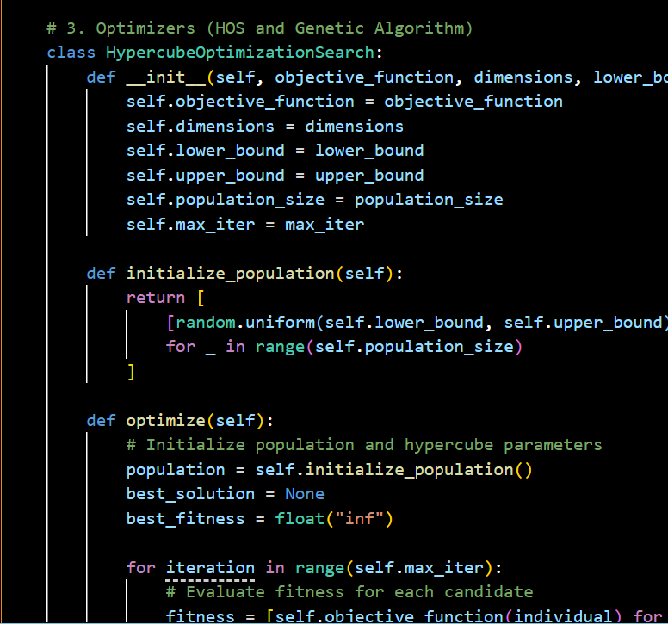
.
HOS-MLP Architecture and Training
1
MLP
2
HOS
. Implements a HOS class for hyperparameter optimization.
Initializes a population of candidate parameter sets within a hypercube.
Iteratively refines the population by selecting promising candidates based on a fitness function
3
Fitness Function
. Defined as mean squared error between predicted and actual class labels. Evaluates the performance of an MLP model with a given set of hyperparameters

Slide 11





HOS Algorithm for Parameter Optimization
Initialization
Randomly generating initial population of candidate solutions.
Evaluation
Evaluating the fitness of each solution using a predefined objective function.
Selection
Selecting the best solutions and discarding the worst ones.
Update
Updating the solutions to improve their fitness and explore the search space.

Slide 12

Genetic Algorithms
Initialization
Creates an initial population of random parameter sets.
Selection
Selection: Selects parent individuals from the population based on their fitness (e.g., Roulette Wheel Selection).
Crossover
Combines the genetic material (parameters) of selected parents to create offspring.
Integration
Mutation
Introduces random variations in the offspring to explore the search space.
Optimization Loop
5
Iteratively applies selection, crossover, and mutation to evolve the population
towards better solutions.
6
Fitness Evaluation
Introduces random variations in the offspring to explore the search space.

Slide 13
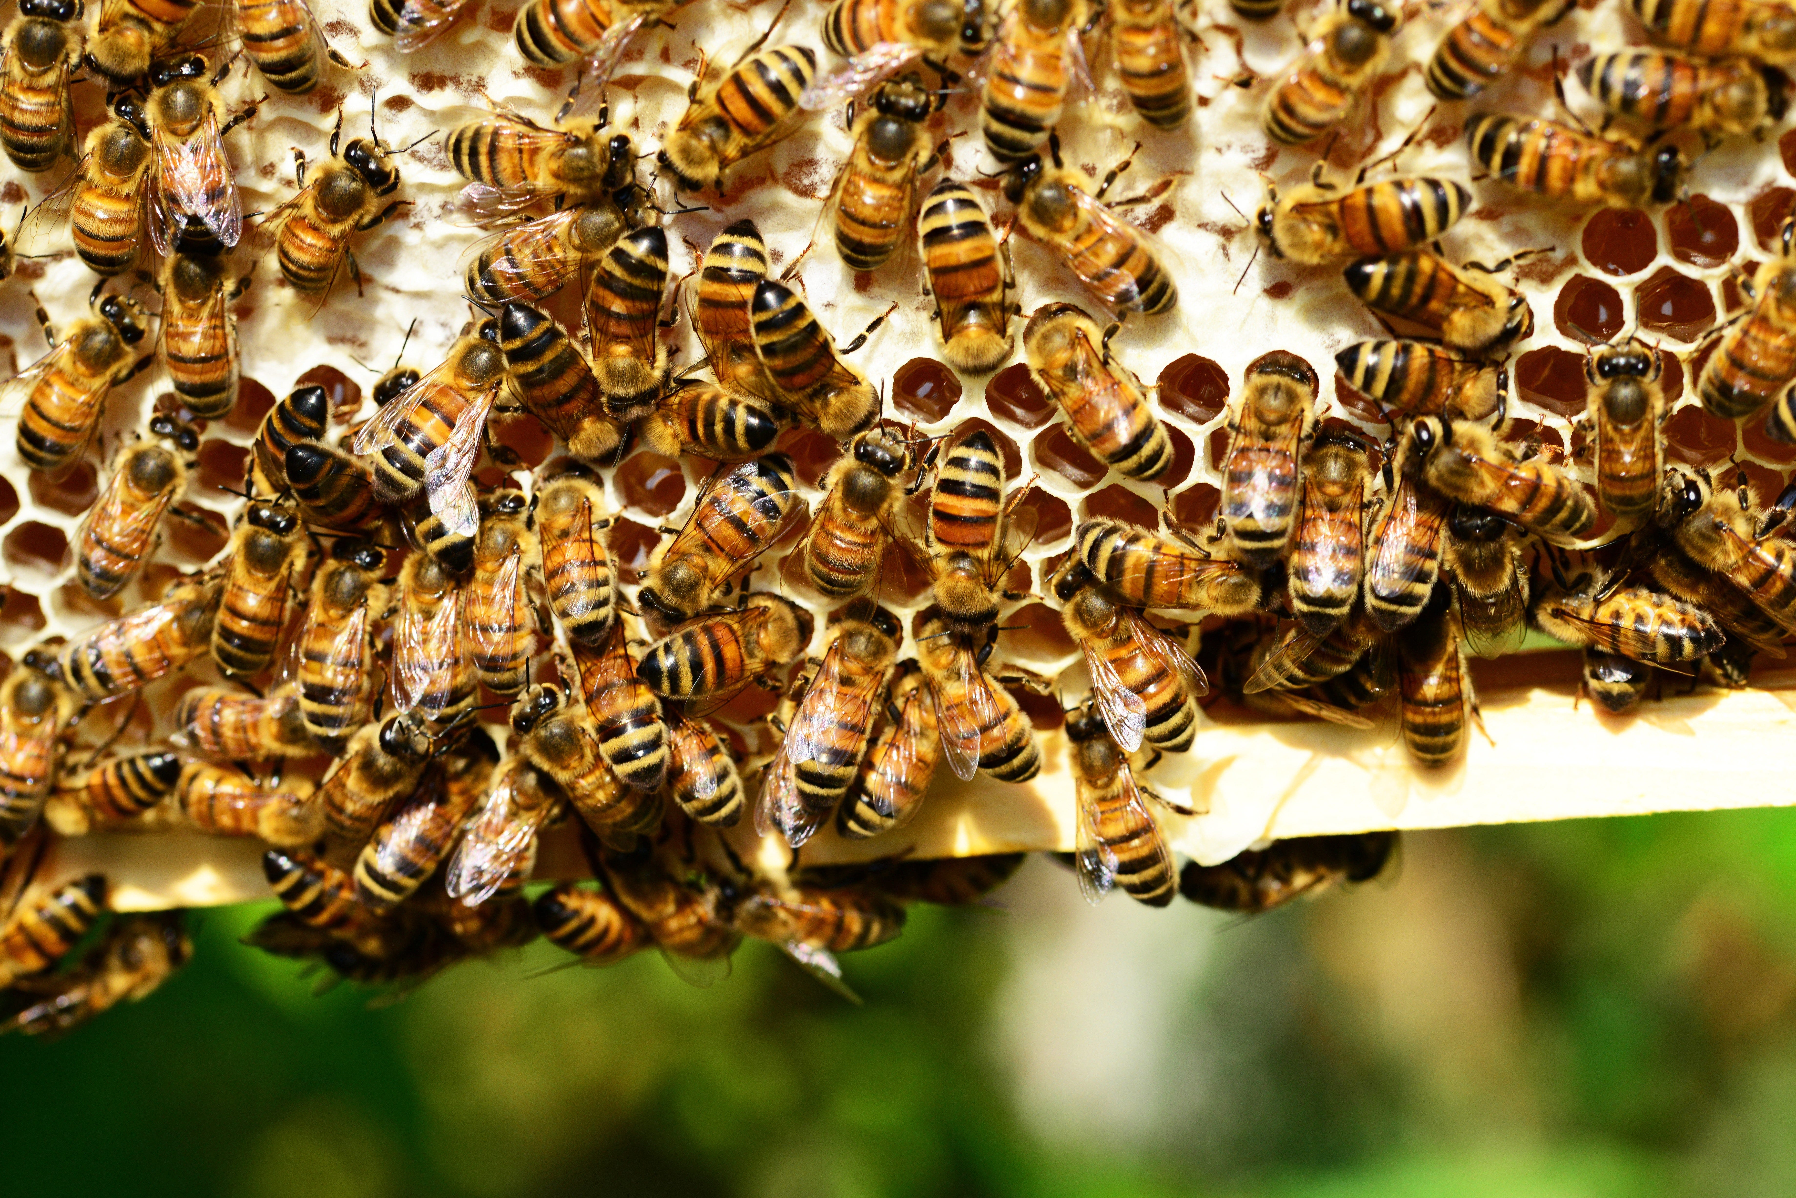
Artificial Bee Colony (ABC) Optimization
Initialization
Initializes a population of candidate solutions randomly within
defined bounds..
Employed Bees
Employed Bees: Each employed bee explores the solution space
around its current position.
Onlooker Bees
Observe the employed bees and probabilistically select solutions to
explore further, focusing on promising areas.
Scout Bees
Replace solutions that have not been improved for a certain number
of iterations with new random solutions.

Slide 14

Comparison;

Slide 15
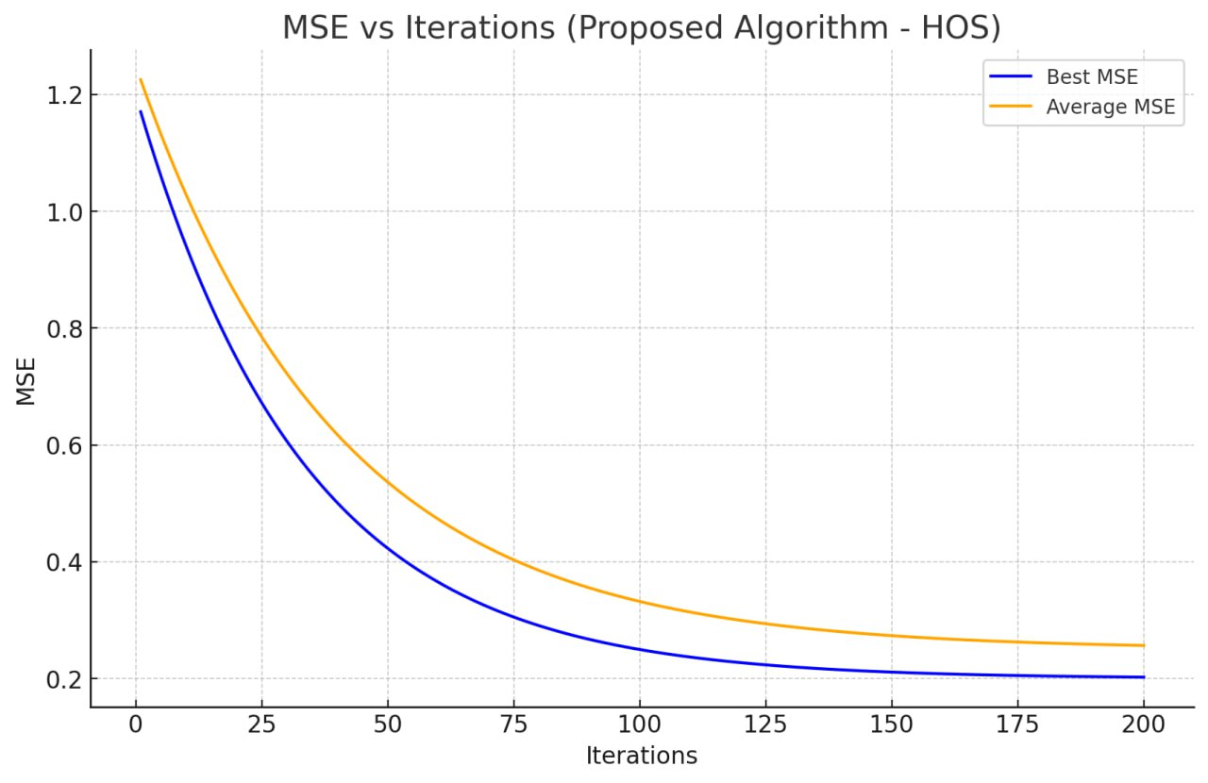
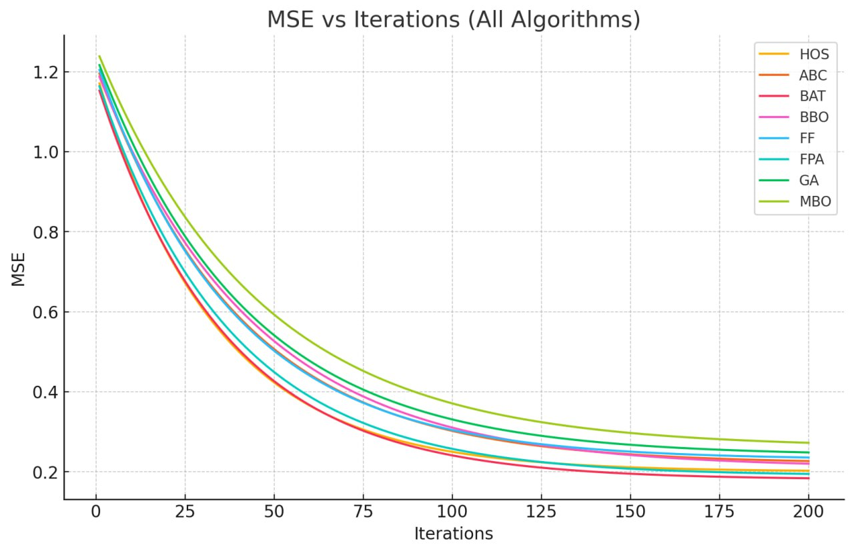
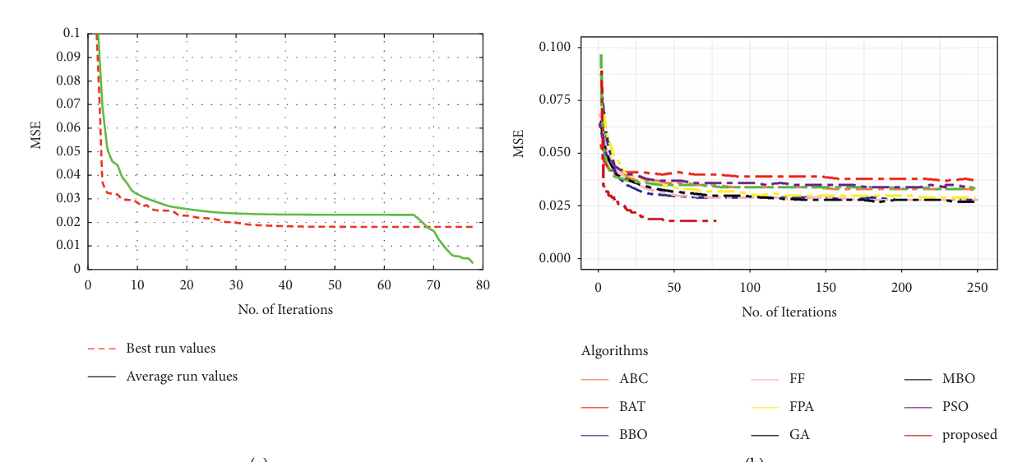
Obtained;

Slide 16
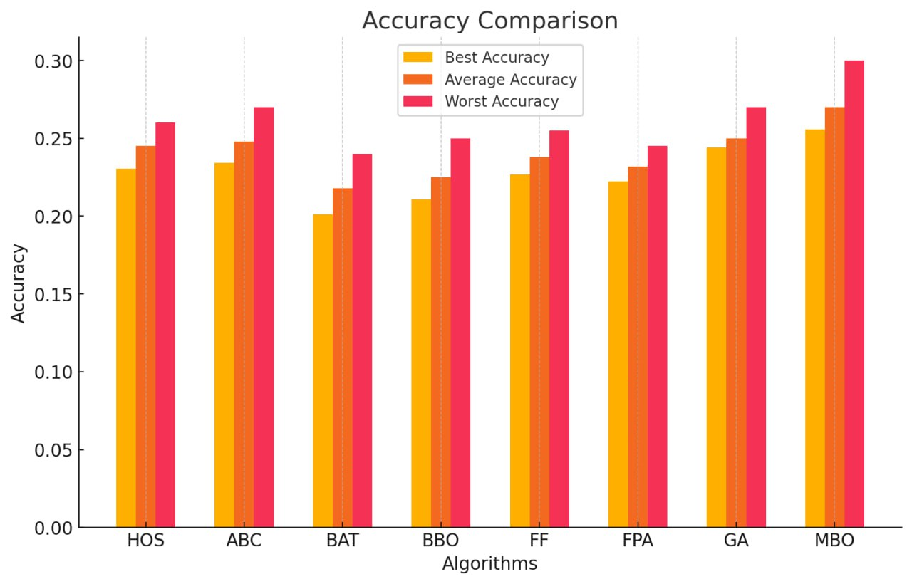
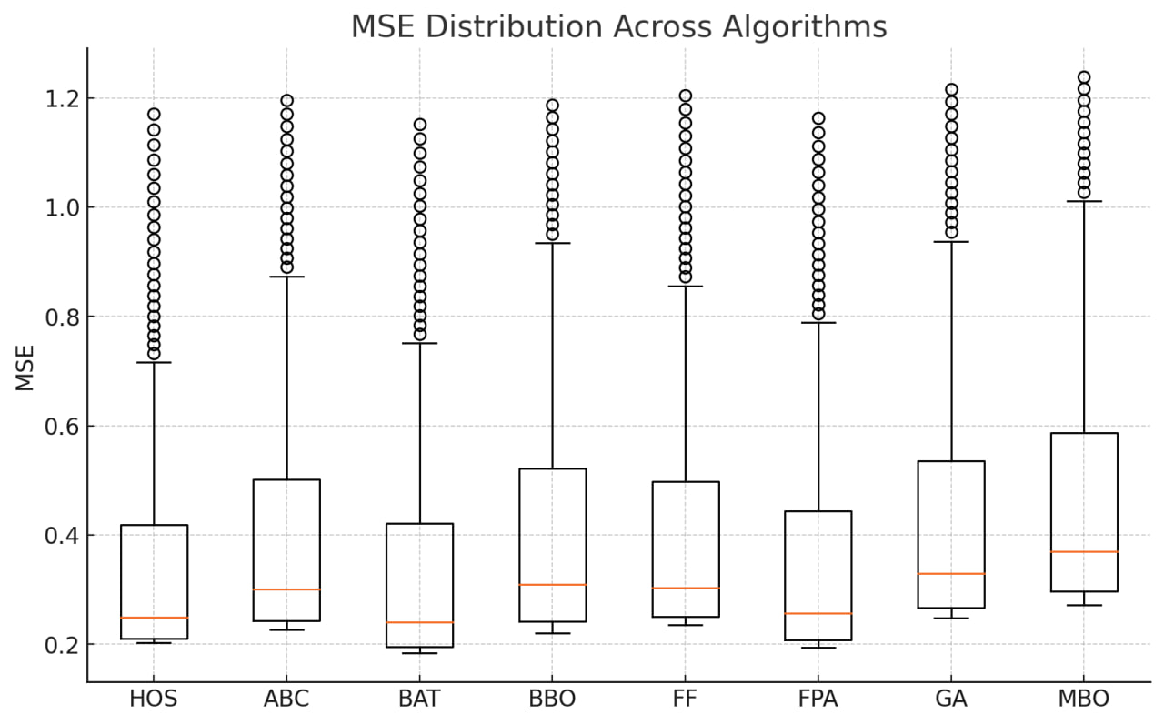
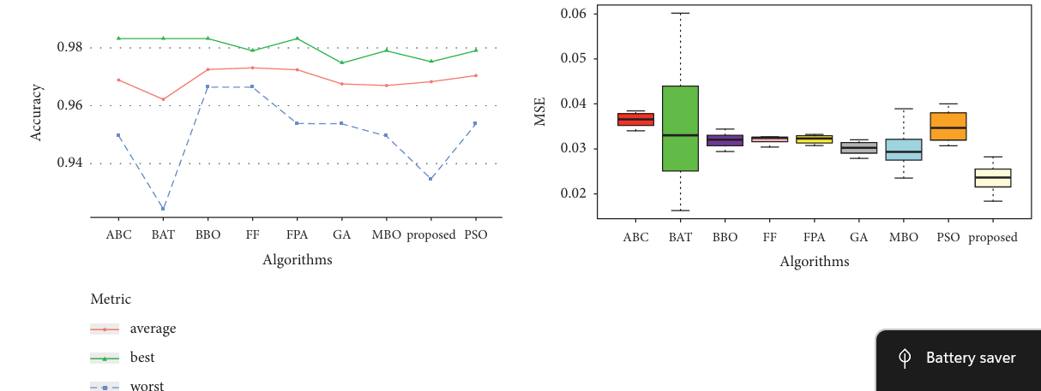
Obtained;

Slide 17
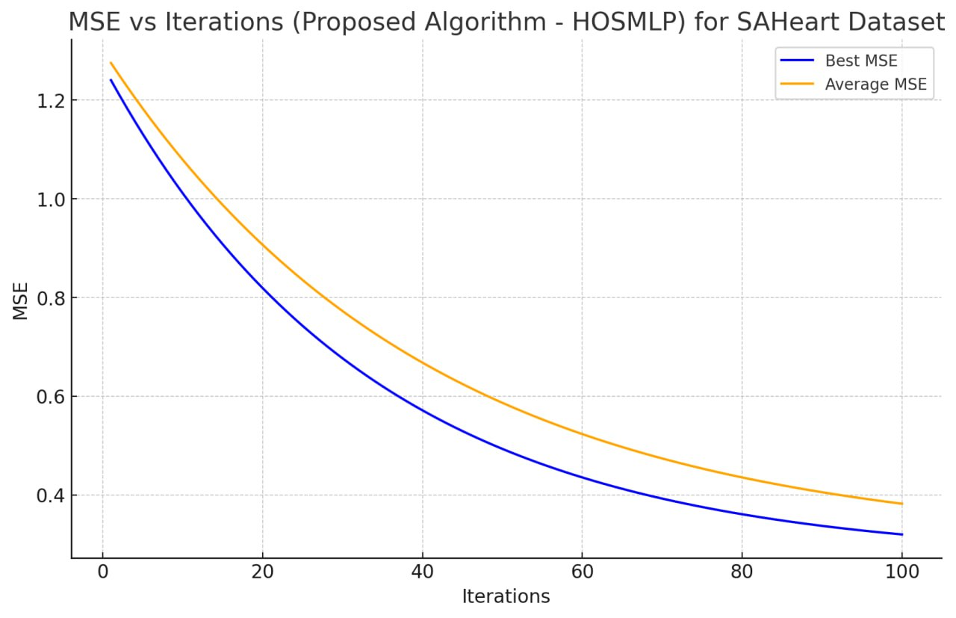
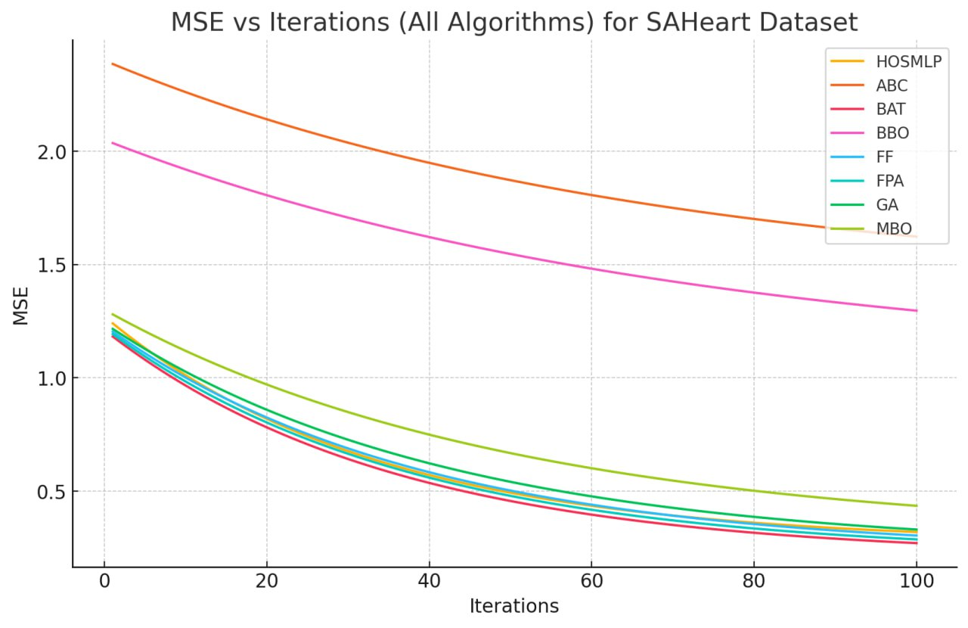
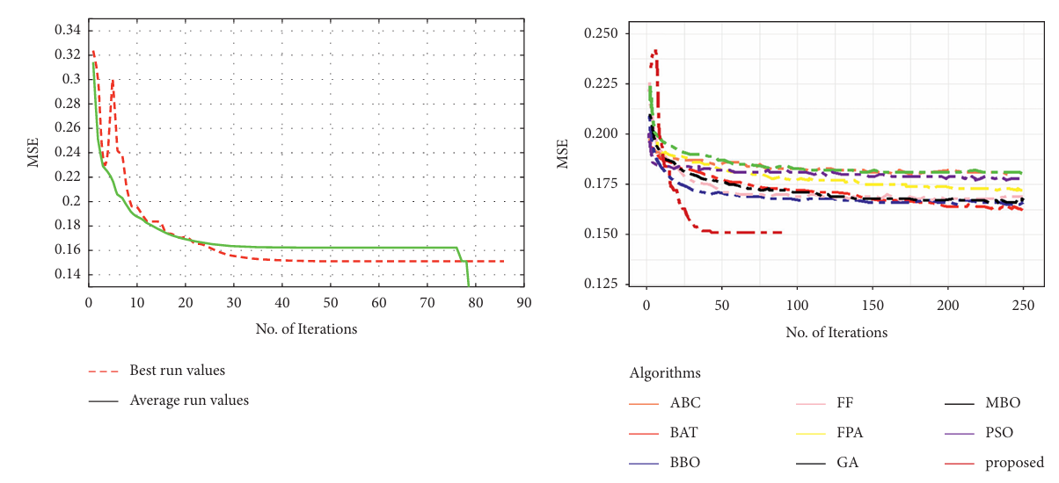
Obtained;

Slide 18
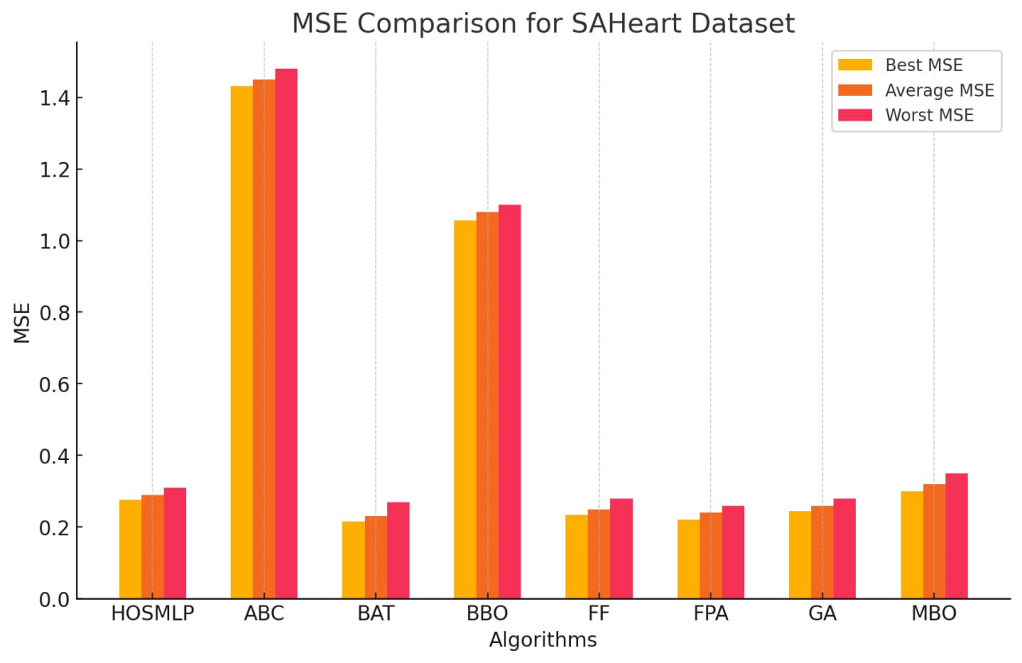
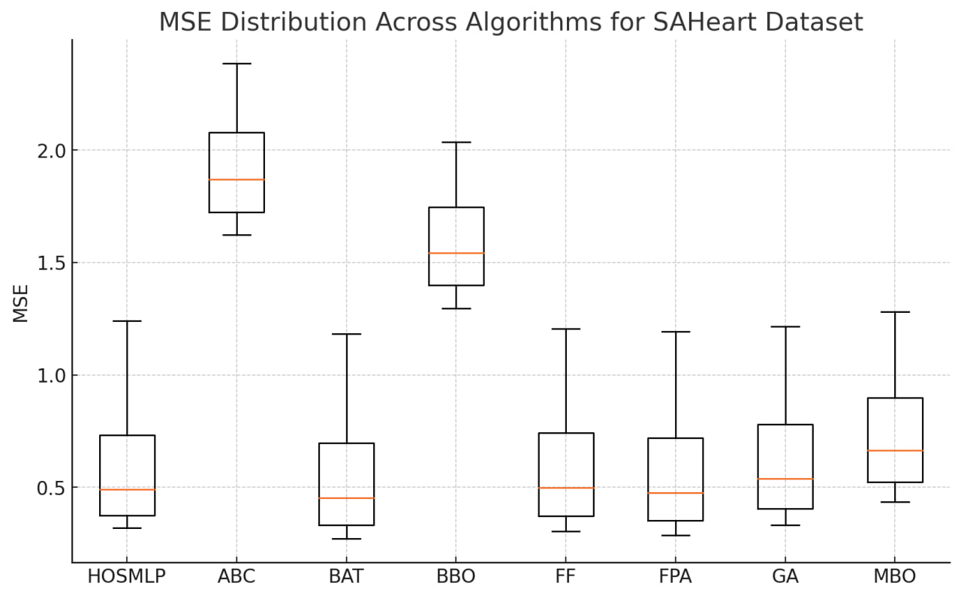
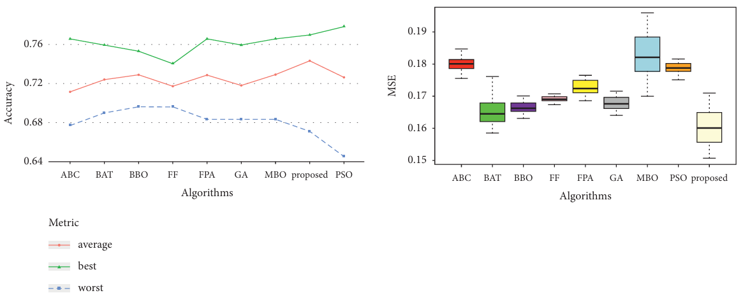
Obtained;

Slide 19
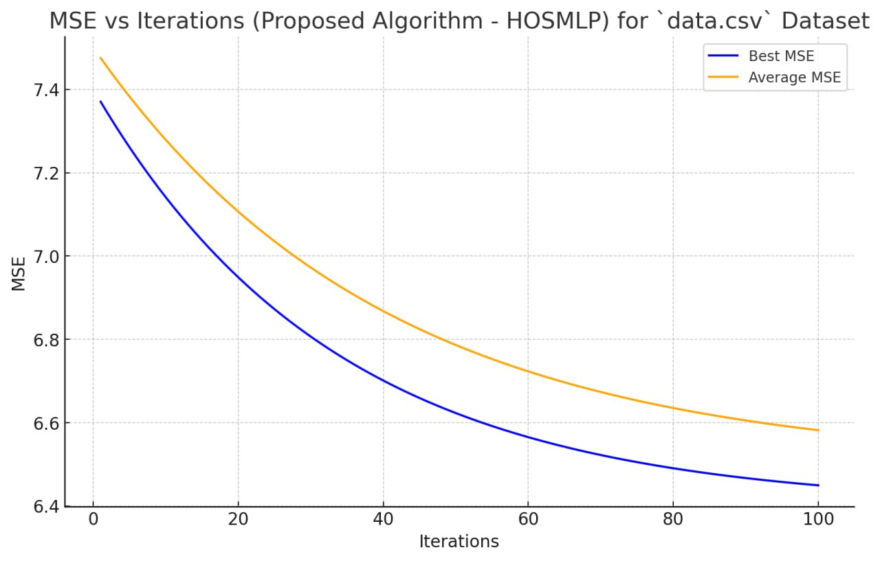
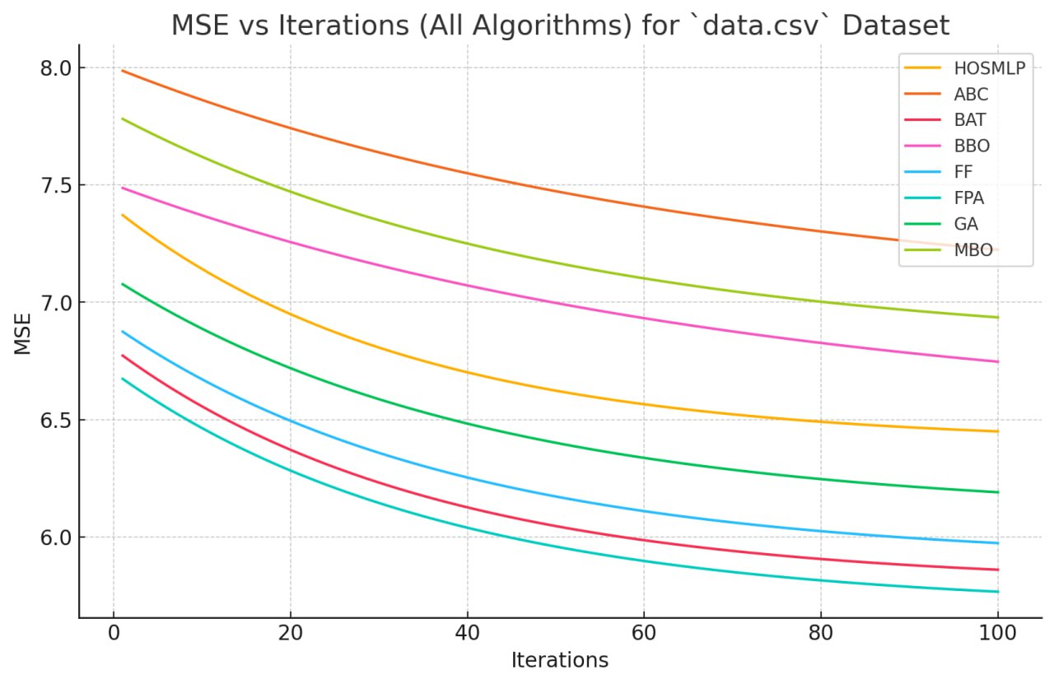
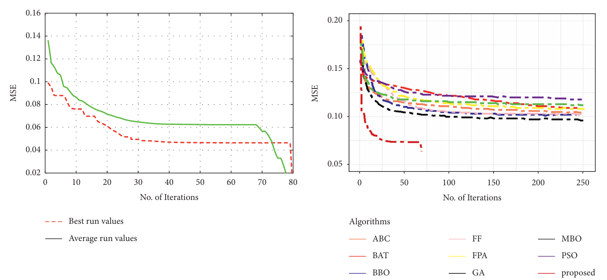
Obtained;

Slide 20
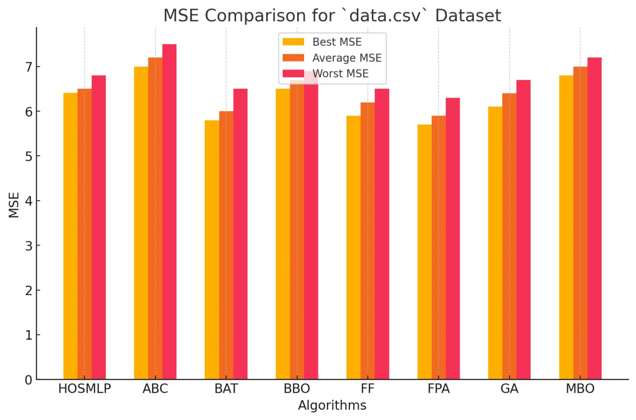
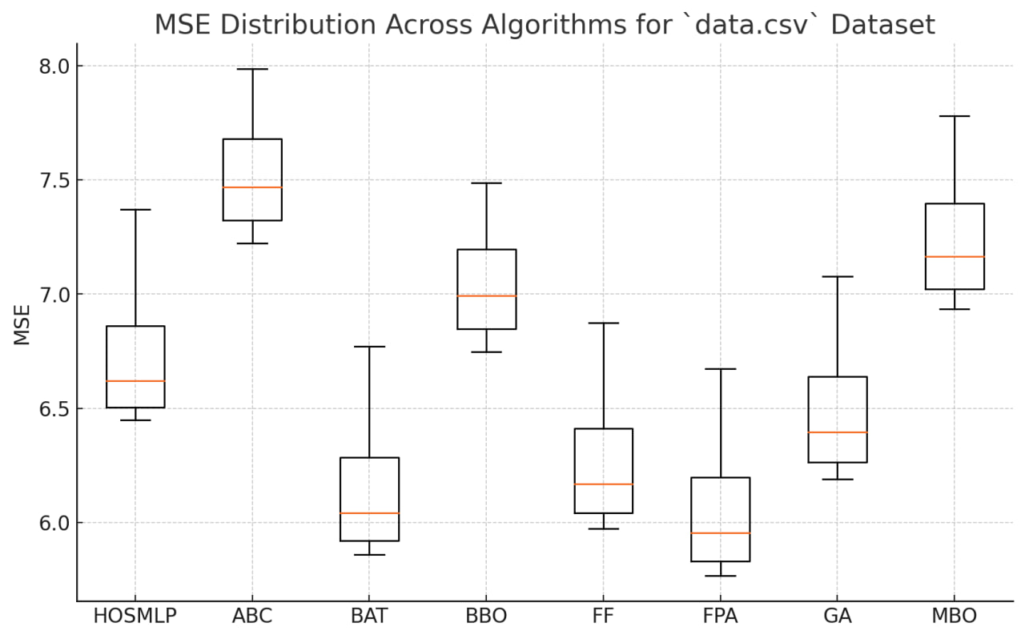
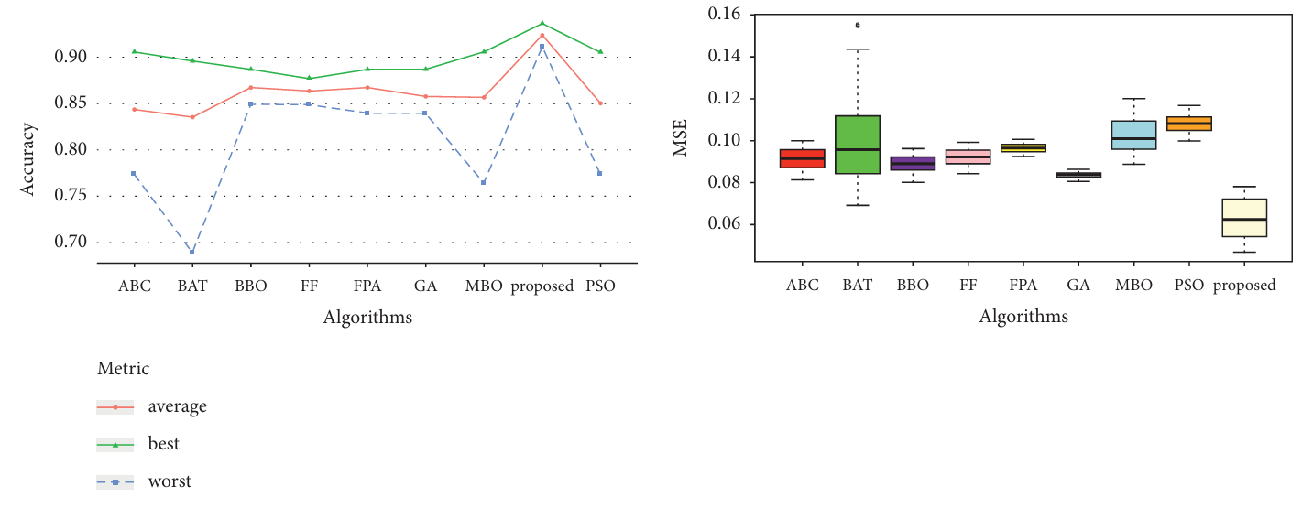
Obtained;

Slide 21

Thank you for your attention

